Slide 1
Exploratory Data Analysis on Iris Dataset
Muneerath Sajila
Batch no:7230

Slide 2
OBJECTIVE
To perform Exploratory Data Analysis on the Iris dataset.

Slide 3
What is Exploratory Data Analysis?
Exploratory Data Analysis (EDA) is a technique to analyze data using some visual Techniques.
With this technique, we can get detailed information about the statistical summary of the data.
We will also be able to deal with the duplicates values, outliers, and also see some trends or patterns present in the dataset.

Slide 4
Iris Dataset
Iris Dataset is considered as the Hello World for data science.
It contains five columns namely – Petal Length, Petal Width, Sepal Length, Sepal Width, and Species Type.
Iris is a flowering plant, the researchers have measured various features of the different iris flowers and recorded them digitally.

Slide 5
ANALYSIS METHODS:
First, we load the dataset using the pandas library.
Pandas is defined as an open-source library that provides high-performance data manipulation in Python.
It can perform five significant steps required for processing and analysis of data irrespective of the origin of the data, i.e., load, manipulate, prepare, model, and analyze.
In order to load the dataset we use the dataframe.read_csv().

Slide 6
1.Getting Information about the Dataset
We will use the shape parameter to get the shape of the dataset.
It will show the count of rows and columns of the dataset.
Eg:(140,6)
2. describe() method:
The describe() function applies basic statistical computations on the dataset like extreme values, count of data points standard deviation, etc.
Any missing value or NaN value is automatically skipped. describe() function gives a good picture of the distribution of data.

Slide 7
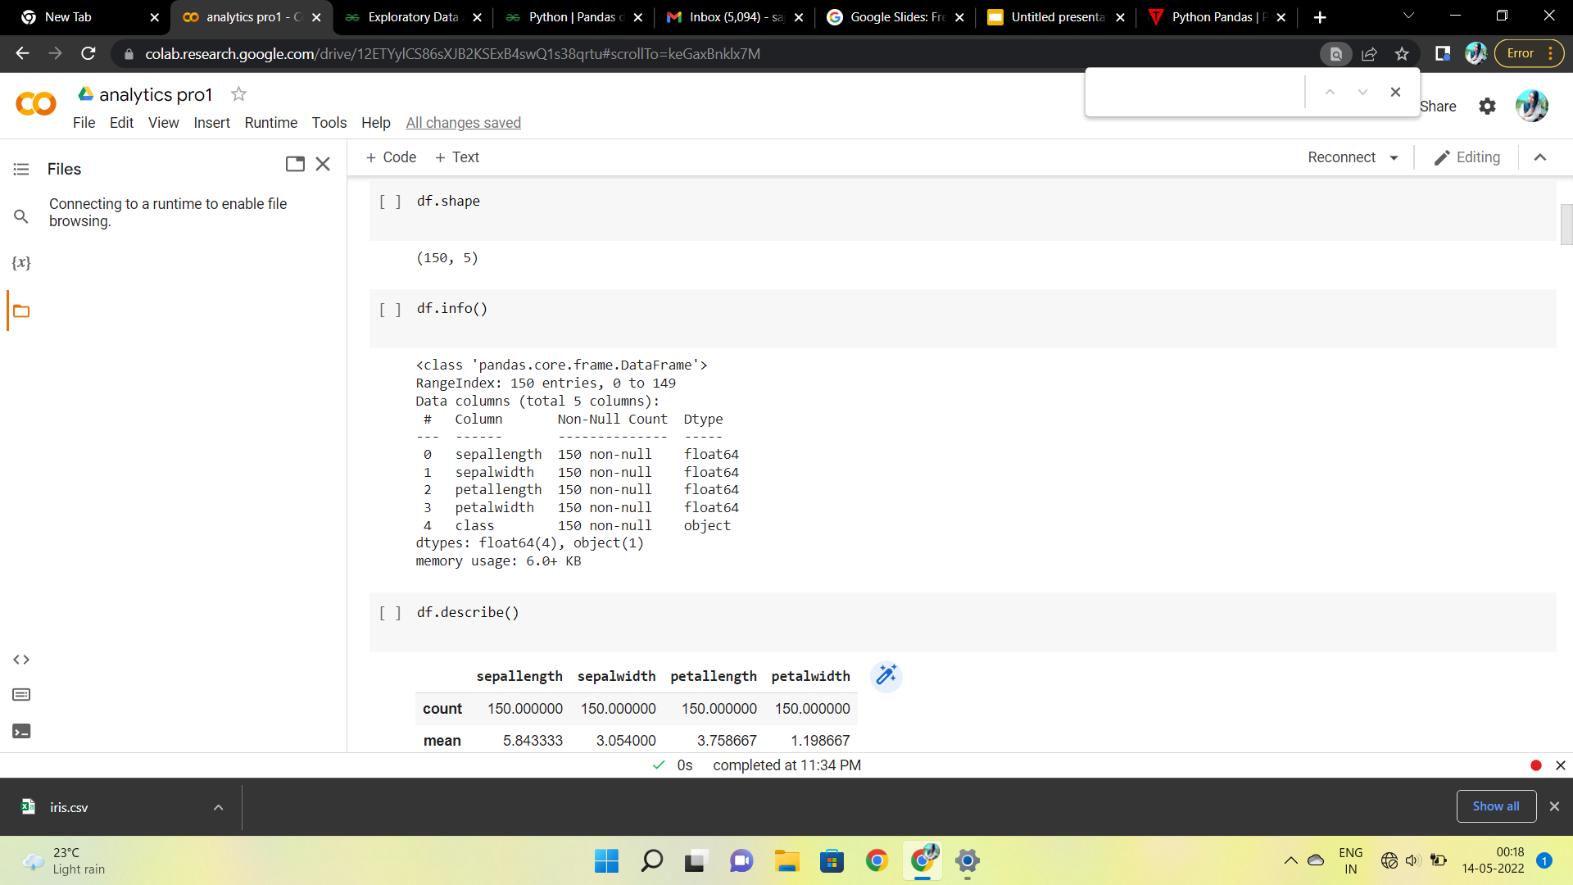

Slide 8
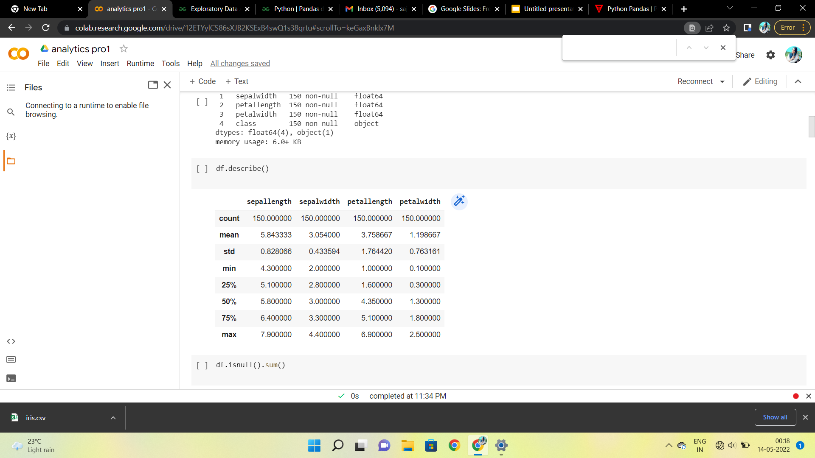

Slide 9
3.Checking Missing Values
Missing values can occur when no information is provided for one or more items or for a whole unit. We will use the isnull() method.
4.Checking Duplicates
Pandas drop_duplicates() method helps in removing duplicates from the data frame.
5.Data Visualization
We will use Matplotlib and Seaborn library for the data visualization.

Slide 10
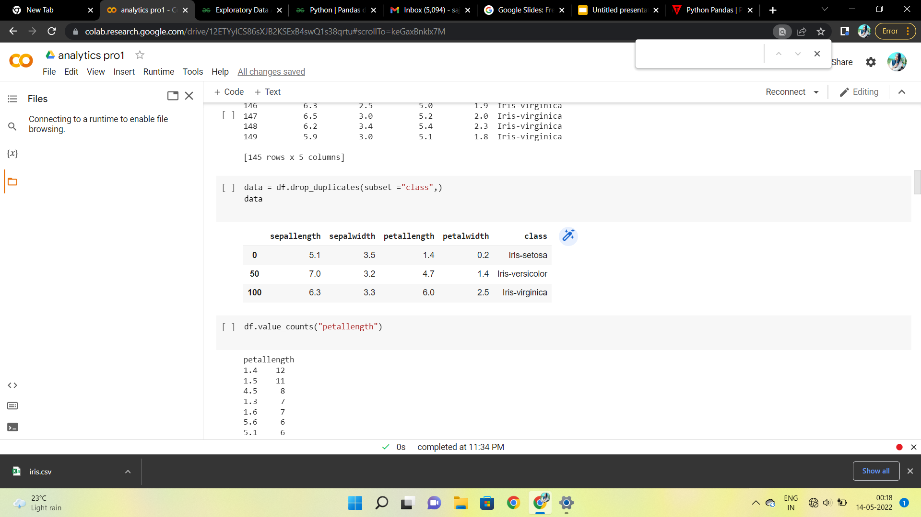

Slide 11
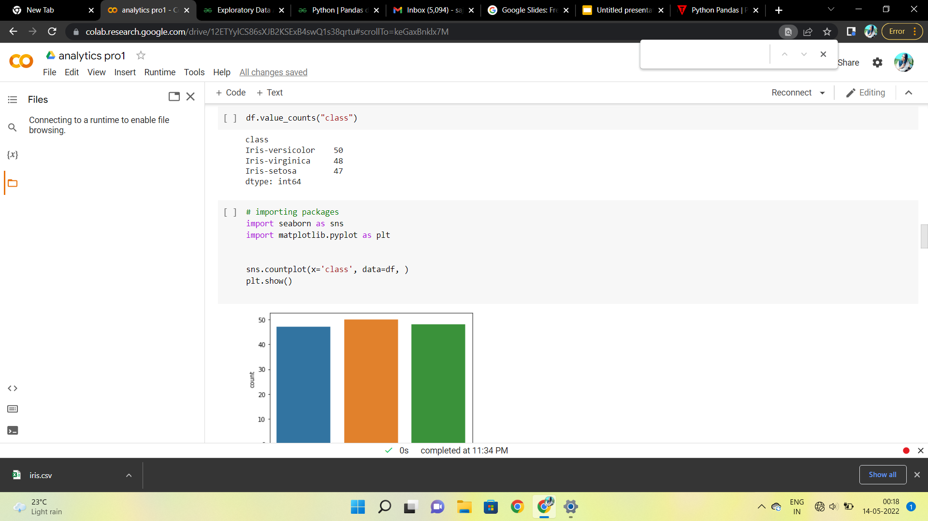
We can use histograms,barchart,pairplot,heatmap etc to show visualize the dataset
.

Slide 12
By using the charts we can see the relationships of certain columns , rows etc.
For example we can see the relationship between the sepal length and sepal width and also between petal length and petal width.

Slide 13
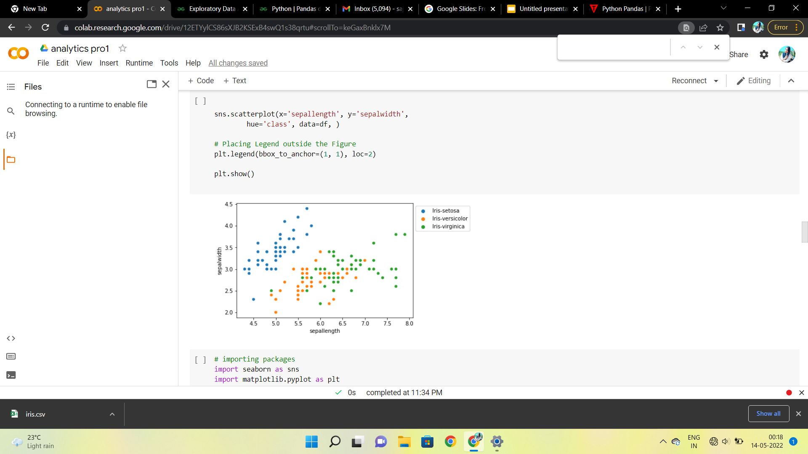

Slide 14
From the above plot, we can infer that –
Species Setosa has smaller sepal lengths but larger sepal widths.
Versicolor Species lies in the middle of the other two species in terms of sepal length and width
Species Virginica has larger sepal lengths but smaller sepal widths.

Slide 15
THANK YOU

